Slide 1
24
7
30
Date
Units of length
EQ – How do I covert between metric units of length?
5

Slide 2

24
7
30
Date
Units of length
EQ – How do I covert between metric units of length?
Converting Units
Converting Units
x1000 x 100 x10
km m cm mm
km m cm mm
$÷$1000 $÷$100 $÷$10
5

Slide 3

24
7
30
Date
Units of length
EQ – How do I covert between metric units of length?
Converting Units
Converting Units
x1000 x 100 x10
km m cm mm
km m cm mm
$÷$1000 $÷$100 $÷$10
Change the following to the given units
5m to cm
780mm to cm
2.4km to cm
5

Slide 4
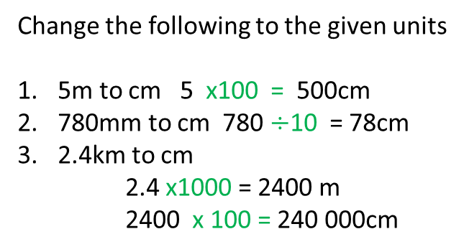
24
7
30
Date
Units of length
EQ – How do I covert between metric units of length?
Converting Units
Converting Units
x1000 x 100 x10
km m cm mm
km m cm mm
$÷$1000 $÷$100 $÷$10
Change the following to the given units
5m to cm 5 x100 = 500cm
780mm to cm 780 $÷$10 = 78cm
2.4km to cm
2.4 x1000 = 2400 m
2400 x 100 = 240 000cm
5

Slide 5
24
7
30
Date
Units of length
EQ – How do I covert between metric units of length?
What do the prefixes mean?
Prefix | Meaning | Example
centi | One hundredth ÷ by 100 | Centimetre 100cm = 1m Centigrade 100˚
milli | One thousandth ÷ by 1000 | Millimetre 1000mm = 1m Milligram 1000mg = 1g Millilitre 1000mL = 1L
kilo | One thousand x by 1000 | Kilogram 1000g = 1kg Kilometre 1000m = 1km
5

Slide 6
Notes Review
24, 7 ,30
Date
Title
Essential question
Notes complete
Notes complete with colour and diagrams
Questions completed
Contents page filled in
Formula page filled in

